Slide 1
SOEN341
SCRUM
Product Backlog

Slide 2
Product Backlog
The product backlog:
A prioritized list of desired product functionality.
A centralized understanding of what to build and the order in which to build it.
A highly visible artifact at the heart of the Scrum framework that is accessible to all project participants

Slide 3
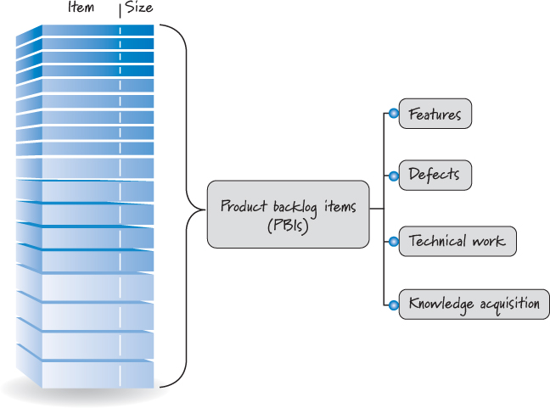
Backlog Diagram

Slide 4
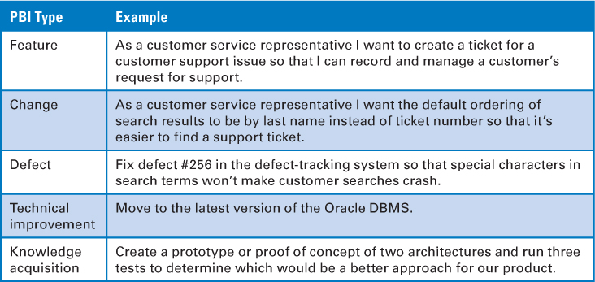
Backlog items

Slide 5
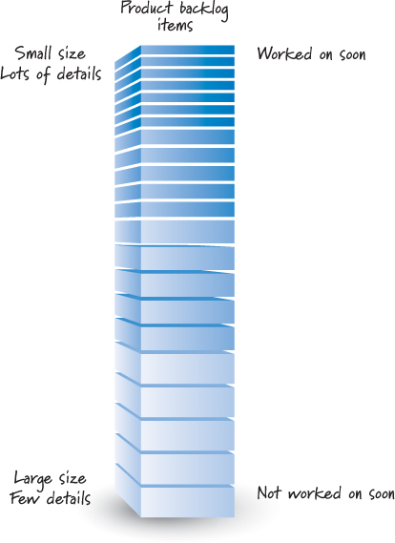
Levels of detail

Slide 6
PB Items
PBIs that we plan to work on soon should be near the top of the backlog, small in size, and very detailed so that they can be worked on in a near-term sprint.
PBIs that we won’t work on for some time should be toward the bottom of the backlog, larger in size, and less detailed
As we get closer to working on a larger PBI, such as an epic, we will break that story down into a collection of smaller, sprint-ready stories. This should happen in a just-in-time fashion.
The structure of the product backlog is constantly emerging over time.
As new items are added or existing items are refined, the product owner must rebalance and reprioritize the product backlog,

Slide 7
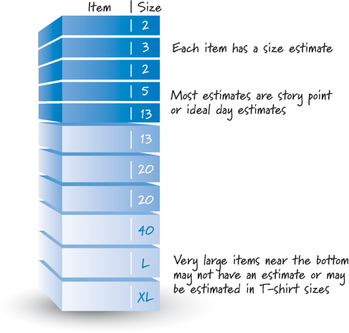
Each product backlog item has a size estimate corresponding to the effort required to develop the item

Slide 8
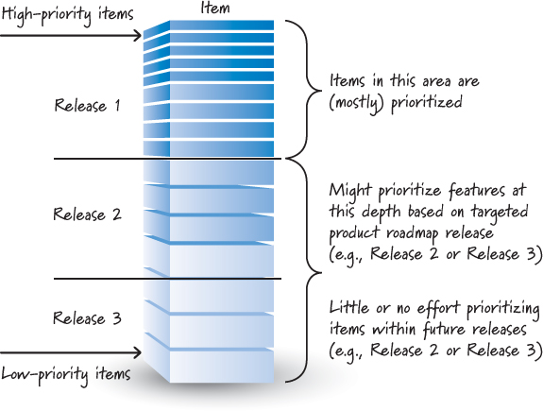
Although the product backlog is a prioritized list of PBIs, it is unlikely that all of the items in the backlog will be prioritized

Slide 9
Grooming
It is useful to prioritize the near-term items that are destined for the next few sprints.
It is valuable to prioritize as far down in the backlog as we think we can get in Release 1
As new items emerge during the course of development, the product owner is responsible for inserting them in the correct order based on the items that currently exist in the backlog.
Grooming refers to a set of three principal activities: creating and refining (adding details to) PBIs, estimating PBIs, and prioritizing PBIs.

Slide 10
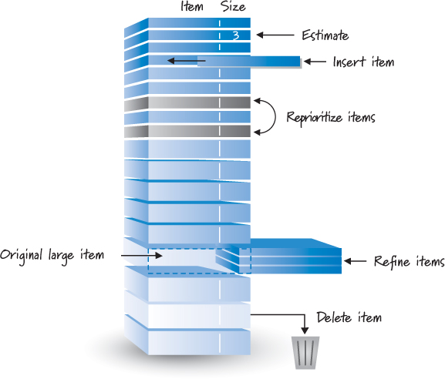
Grooming

Slide 11
When
Initial grooming occurs as part of the release-planning activity
The product owner might schedule either a weekly or a once-a-sprint grooming workshop during sprint execution.
Doing so ensures that grooming occurs on a regular schedule
Most teams find that they do some grooming as part of the sprint review during sprint planning.

Slide 12
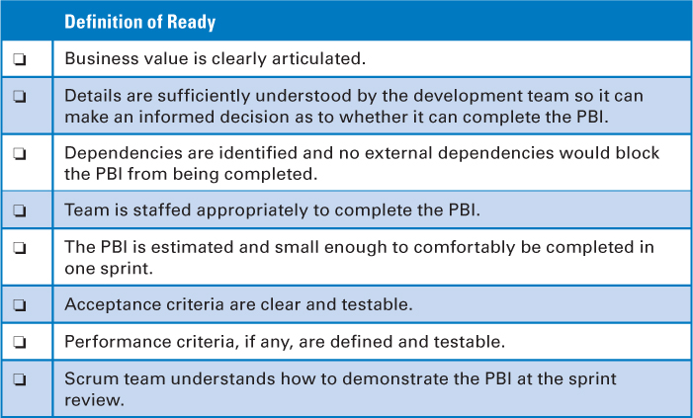
Definition-of-Ready Checklist

Slide 13
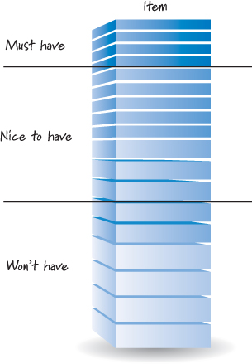
Flow management

Slide 14
Estimation and Velocity
We need to estimate the size of what we are building and measure the velocity or rate at which we can get work done.
At the end of each sprint, we simply add the size estimates of every item that was completed during the sprint; if an item isn’t done, it doesn’t count toward velocity.
The sum of the sizes of all the completed product backlog items in a sprint is the team’s velocity for that sprint.

Slide 15
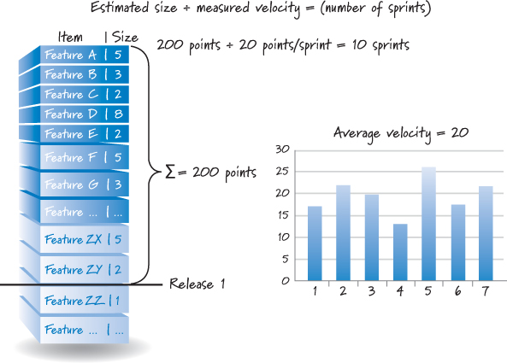
Estimate and Velocity

Slide 16
Ideal Hours
Tasks are sized in ideal hours (also referred to as effort-hours, man-hours, or person-hours).
The team estimates that the UI task will take five effort-hours to complete. That doesn’t mean it will take five elapsed hours. It might take one person a couple of days to code the UI, or it could take a couple of people working together less than a day.
The estimate simply states how much of the team’s effort is expected to complete the task.

Slide 17
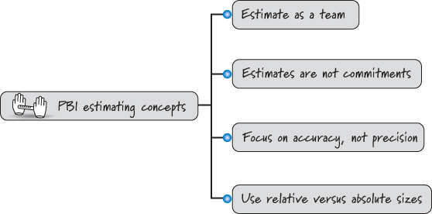
Estimation

Slide 18
PBI sizes
Estimate PBIs using relative sizes, not absolute sizes. Compare items to determine how large an item is relative to the others
Although there is no standard unit for PBI size estimates, by far the two most common units are story points and ideal days.
Story points combine factors like complexity and physical size into one relative size measure
An alternative approach for estimating PBIs is to use ideal days. Ideal days are a familiar unit—they represent the number of effort-days or person-days needed to complete a story. Ideal time is not the same thing as elapsed time.

Slide 19
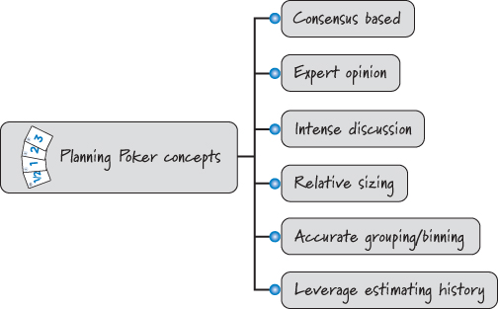
Planning poker

Slide 20
Poker technique
Planning Poker is a consensus-based technique for estimating effort. Knowledgeable people slated to work on a PBI engage in an intense discussion to expose assumptions, acquire a shared understanding, and size the PBI.
Planning Poker yields relative size estimates by accurately grouping or binning together items of similar size. The team leverages its established PBI estimation history to more easily estimate the next set of PBIs.
The full Scrum team participates when performing Planning Poker. During the session, the product owner presents, describes, and clarifies PBIs. The ScrumMaster coaches the team to help it better apply Planning Poker.

Slide 21
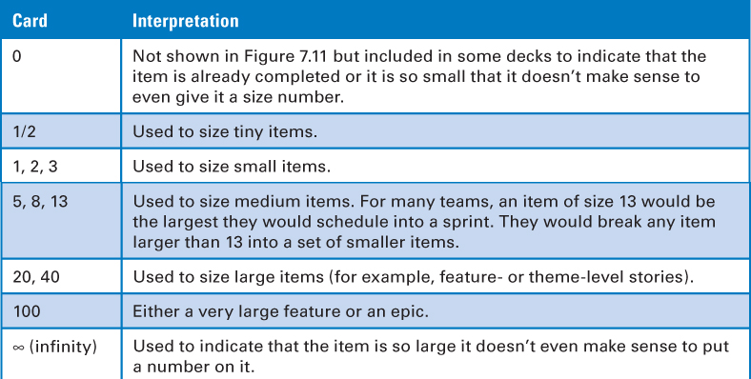

Slide 22
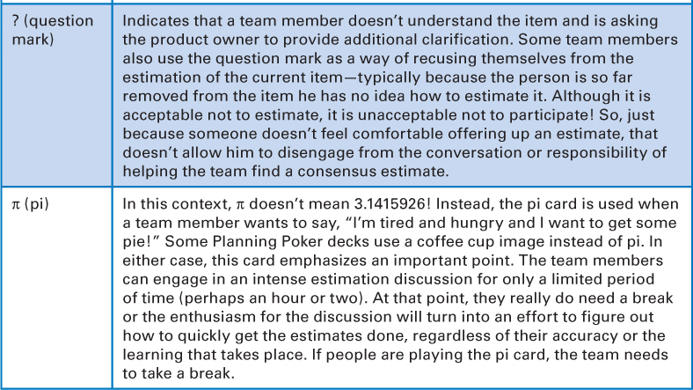

Slide 23
The rules of Planning Poker
1. The product owner selects a PBI to be estimated and reads the item to the team.
2. Development team members discuss the item and ask clarifying questions to the product owner, who answers the questions.
3. Each estimator privately selects a card representing his estimate.
4. Once each estimator has made a private selection, all private estimates are simultaneously exposed to all estimators.
5. If everyone selects the same card, we have consensus, and that consensus number becomes the PBI estimate.
6. If the estimates are not the same, the team members engage in a focused discussion to expose assumptions and misunderstandings. Typically we start by asking the high and low estimators to explain or justify their estimates.
7. After the discussion, we return to step 3 and repeat until consensus is reached.

Slide 24
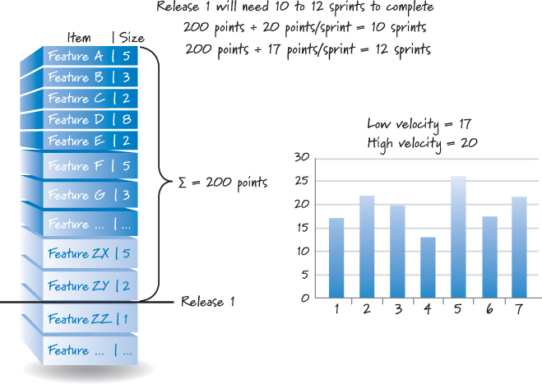
For planning purposes, velocity is most useful when expressed as a range, such as “The team is typically able to complete between 25 and 30 points each sprint.

